Slide 1

Project EVA
Brain tumour classification using Deep learning techniques

Slide 2


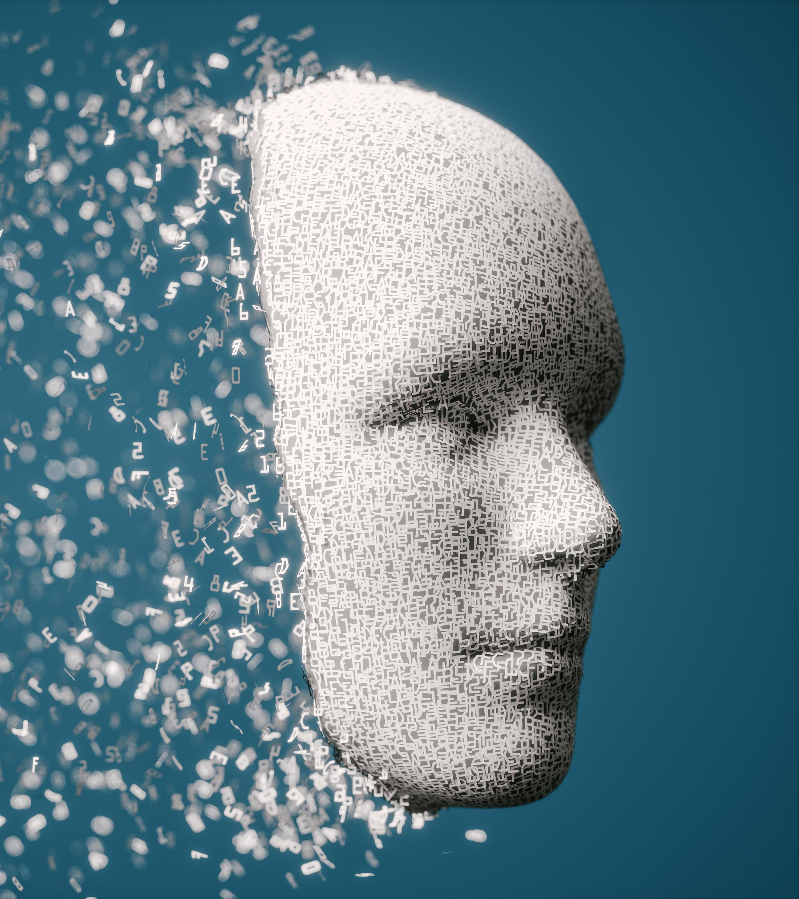
Introduction
Notes:
Good [morning/afternoon/evening], everyone. Welcome to our presentation on EVA, which stands for Evolutionary Visual Analytics.
Today, we'll be taking you through the various aspects of our project, starting with an introduction to the problem and the data used.
Following the problem intro & data intro, each team member will delve into the different methodologies and techniques we employed. This will give you a comprehensive understanding of the diverse approaches we explored and how they contributed to the overall success of the project.
After covering our methodologies, we'll move on to a demo of the front end of our application. This will provide a visual overview of how EVA works in practice. Subsequently, we will demonstrate some key sections of our code to showcase the underlying processes and logic that drive EVA.
We’ll end with our experience working together as a team. Collaboration was a key component of this project, and we’re excited to share how we effectively combined our efforts to achieve our goals.
Finally, we will open the floor to any questions you may have. We’re eager to discuss our project further and address any queries or insights you might have.
Thank you for your attention, and we hope you find our presentation both informative and engaging.

Slide 3

The Problem
Aim: To explore and evaluate modern AI methods to aid brain tumour classification.​
Using:​
1. Convolutional Neural Networks​
2. Semi-Supervised Deep Learning and Supervised Reinforcement Learning​
3. Machine Learning
Group Report:
Introduction
Data
Methodologies and Literature Review
(Method) Pre-Processing, Architecture, Training and Results
Notes:
To tackle the report, a clear aim was defined. As suggested, we aim to use advanced artificial intelligence techniques to help in the classifications of brain tumours.
There are three ways that we went about solving the same problem: CNNs which I will further go into, Semi-Supervised with Victoria and Machine Learning with Aziz.
Collectively, this information was shared, and the first 6 pages of the entire report consist of group work and define this problem concisely.
The report produced together consists of these headings.
The introduction introduces the topic which we aim to approach using various methods of AI reasoning, research shows that there are significant challenges around the aggressive nature of brain tumours, accounting for around 3.4% of all cancers. With the advancements in AI and machine learning, the accuracy and speed of diagnosis will be key for future methods to enhance patient outcomes. We all came to the conclusion that computer vision was the main subject of focus so we could experiment the techniques we have learnt on the duration of this course whilst broadening our knowledge in this specific domain also.
The data used is used and accessed on Kaggle, and we all used the same data set of MRI scans of brain scans split into 4 labelled sections.
The methodologies are briefly described for each of our different subject areas and a literature review used to aid the readers understanding of the aims and objectives of the research paper produced.
From the reviews of secondary research, our own methods of pre-processing data, system architecture, training and optimisation and tgen results produced were explored. Which leads me into each of our methods

Slide 4
Convolutional Neural Networks
About Convolutional Neural Networks
System Proposal
Methodology and Problem Definition
Data Preprocessing
Architecture Design
Training
Evaluation
Results and Analysis
Notes:
Starting with the first, CNN is the method that I explored..
The first question was why use CNNs? After reviewing much literature, it was obvious the plethora of applications that these neural networks provide. Within image processing, they have been credited with abilities to identify and extract features with high levels of classification accuracy being resulted.
The way they work is by using a mathematical design which uses gridded patterns seen in images to be processed. They use: convolution, pooling and fully connected layers to mimic the design of a human brain. The limitations of using this method is the time of processing and computational complexity.
The methodology of the system proposed included firstly defining the problem, then preprocessing of data, creating an architecture for the system, compiling and training, then finally evaluating and fine tuning the model.
The problem defined is to classify brain tumours using a CNN with the data set accessed on Kaggle.
The data preprocessing neccassary was to mount the data onto the Google drive, to be accessed on Google Colab to avoid RAM usage conditions and having to load the data each time. The images were rescaled so they were able to be read on Python and additionally training, validation and testing sets were split and used for the evaluation of the model.
The design of the architecture includes:
An input layer, convolutional layers, pooling layers, dropout layers, flatten layers, fully connected layers and an output layer.
To train the model, the system learns through the number of epochs thar are ran. As CNNs have been known to be computationally complex, this was applied with a very finite amount of epochs. Benchmarks are used to compare between the runs.
To evaluate the CNN system, metrics are used when compiling the model. This shows the accuracy of classification in a percentage. Confusion matrices are also supplied to underpin any overfitting and further explain the behaviour of the system. As the data is split into training, validation and test groups, there are loss and accuracy metrics provided for these three groups. Reciever operator characteristic graphs are also provided to show the true positive against false positive rate.
The evaluation shows the results using these methods and supplies recommendations on how to improve the system.
Finally, the results are presented with analysis which I will go into further details regarding now

Slide 5
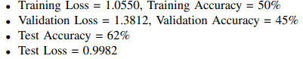
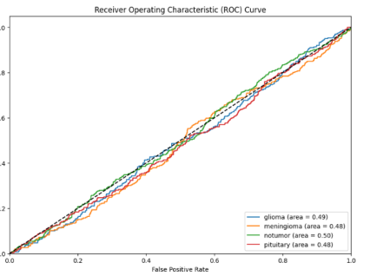
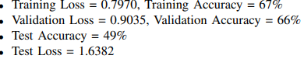
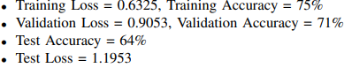
Convolutional Neural Networks: Results
Benchmark 1
Benchmark 2
Benchmark 3
Notes:
Presented is the summary of results with the benchmarks being used to compare upon. A reciever operator characteristic graph for benchmark 1 is supplied. As the x axis tend to the y, it suggests that the results are random. This is the way neural networks work, via trial and error and therefore it makes sense as to why the graph looks the way it does, especcially without a significant amount of training. For the first benchmark, the training accuracy is relatively low at 50% indicating that the model has began to learn but is far from any optimal solution. In the validation phase, the loss is higher and accuracy lower suggesting the system is not generalising well, as it has only been ran once.
Moving onto the second benchmark, there is more time for the system to learn, the loss decreases to 0.797 and accuracy improves to 67% during training, suggesting that the model is learning. In the validation phase, the loss decreases again and accuracy improves over the first benchmark, suggesting better generalisability.
In the final benchmark shows the training accuracy to increase to 75% being the best of the results outputted. The validation accuracy is also high, suggesting the model is incrementally improving with the more epochs that are ran.
Within testing, the first benchmark shows an accuracy level of 62%, which suggests that the system is fairl well equipped at dealing with unseen data. The loss is lower than validation but higher than training loss, suggesting valuable patterns could be learnt at this stage, but is not optimal as only one epoch has been executed. In benchmark 2, the test accuracy suprisingly drops to 49% and this inconsistency suggests that the model has overfitted at this stage, productingh a poorer generalisability of the test set, with the loss being significantly higher this supports the notation of overfitting, which is common when training data, especially with very finite cases. The third benchmark shows that the accuracy improves to 64% which aligns with the validation accuracy, suggesting the more epochs the better for system accuracy in classification of brain tumours.
I will now move onto victoria, who will explain the method in which she applied to classify brain tumours.

Slide 6
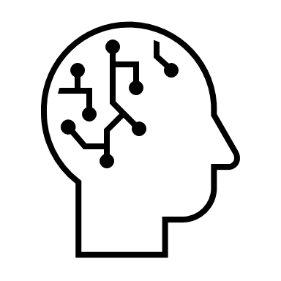
Data Augmentation Techniques
Rotation, Zoom, Horizontal Flip:
Purpose: Increase the diversity of the training dataset.
Benefit: Helps the model generalise better by exposing it to a variety of image orientations and scales.
Width and Height Shifts:
Purpose: Simulate variations in tumour positions.
Benefit: Enhances the model's ability to recognise tumours regardless of their location within the MRI scan.
Brightness Adjustments:
Purpose: Adjust the image brightness.
Benefit: Makes the model robust to different lighting conditions in the images.
Custom Pre-processing Function
Contrast Stretching:
Purpose: Improve image contrast by adjusting pixel intensity ranges.
Benefit: Enhances the visibility of tumour regions, aiding better feature extraction by the model.
Notes:
Here I will be discussing my approach to the project on enhancing brain tumour classification using techniques such as semi-supervised deep learning and reinforcement learning techniques. Let's start with the first slide, which covers the pre-processing and data augmentation techniques employed in this project.
To begin with, data augmentation played a crucial role in increasing the diversity of the training dataset. By applying transformations like rotation, zoom, and horizontal flip, it simulated different orientations and scales of the MRI scans, which helped the model generalise better. Additionally, applying width and height shifts to mimic variations in tumour positions, further enhancing the model's robustness.
Next, I adjusted the brightness of the images to account for different lighting conditions. This ensures that the model remains effective regardless of the brightness levels in the MRI scans. I also made a custom pre-processing function that included contrast stretching. This technique improves image contrast by adjusting pixel intensity ranges, making tumour regions more visible and aiding better feature extraction by the model.

Slide 7
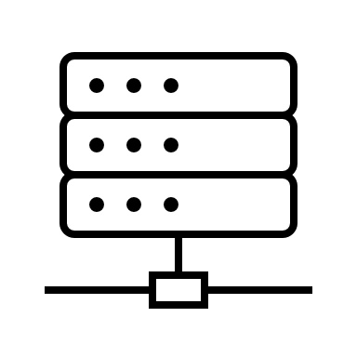
Data Pre-Processing Techniques Continued
Rescaling
Data Splitting
Pixel Value Normalisation:
Purpose: Scale pixel values to the range [0, 1].
Benefit: Ensures consistent input values, improving model performance and training stability.
Custom Pre-processing Function
Contrast Stretching:
Purpose: Improve image contrast by adjusting pixel intensity ranges.
Benefit: Enhances the visibility of tumour regions, aiding better feature extraction by the model.
Notes:
Rescaling the pixel values to the range [0, 1] was another important step. Normalising the pixel values ensures consistent input values, which significantly improves model performance and training stability.
Finally, I divided the dataset into training, validation, and testing sets. This division is crucial as it allows for unbiased evaluation of the model's performance and helps in effectively tuning hyperparameters. By having separate sets for training and evaluation, I can ensure that the model is tested on unseen data, providing a clear measure of its generalisation capabilities.
These pre-processing techniques collectively contributed to creating a robust and diverse dataset, laying a strong foundation for the subsequent machine learning and deep learning methods.

Slide 8

Deep Learning Techniques
VGG16 and EfficientNetB0:
Purpose: Utilise pre-trained models to extract features from images.
Benefit: Leverages existing knowledge from large datasets, reducing the amount of training data and computational resources required.
Custom Model Layers
Fully Connected Layers and Dropout:
Purpose: Add dense layers and dropout for classification tasks.
Benefit: Tailors the pre-trained models to the specific brain tumour classification task, improving accuracy and reducing overfitting.
Hyperparameter Tuning
Keras Tuner (Random Search):
Purpose: Optimise model parameters such as learning rate and dropout rate.
Benefit: Identifies the best hyperparameters, enhancing model performance and efficiency.
Notes:
Moving on, let's discuss the deep learning techniques used in this project.
I began with transfer learning, leveraging pre-trained models such as VGG16 and EfficientNetB0. These models Ire trained on large datasets and have a strong ability to extract features from images. By using these pre-trained models, I could reduce the amount of training data and computational resources required, while still achieving high performance.
On top of these pre-trained models, I added custom fully connected layers and dropout layers. The dense layers tailored the model to the specific task of brain tumour classification, and the dropout layers helped reduce overfitting, ensuring that the model generalised well to new data.
To find the best model parameters, I employed hyperparameter tuning using Keras Tuner's Random Search. This allowed me to systematically vary key hyperparameters such as learning rate and dropout rate, identifying the optimal configuration that enhanced model performance and efficiency.

Slide 9

Deep Learning Techniques Continued
Training Techniques
Early Stopping and ReduceLROnPlateau Callbacks:
Purpose: Monitor model performance during training and adjust learning rates.
Benefit: Prevents overfitting and ensures the model converges to an optimal solution.
Reinforcement Learning
Custom Environment and Reward System:
Purpose: Integrate reinforcement learning elements into the training process.
Benefit: Provides additional rewards for correct classifications, enhancing the model's decision-making capabilities.
Evaluation Metrics
Confusion Matrix and Classification Report:
Purpose: Evaluate the model's performance across different classes.
Benefit: Provides detailed insights into the model's strengths and Weaknesses, guiding further improvements.
Notes:
During training, I utilised important techniques like early stopping and the ReduceLROnPlateau callback. Early stopping monitored the model's performance and stopped training if there was no improvement in validation loss, preventing overfitting. The ReduceLROnPlateau callback adjusted the learning rate when the model's performance plateaued, ensuring that the model continued to improve.
A unique aspect of this project was the integration of reinforcement learning elements. I created a custom environment where the model's actions, such as classifying images, were rewarded or penalised based on correctness. This hybrid approach allowed the model to interact with the environment and enhance its decision-making capabilities through additional rewards for correct classifications.
To evaluate the model, I used a confusion matrix and a classification report. These tools provided detailed insights into the model's performance across different classes, highlighting its strengths and areas for improvement.
In summary, by combining advanced pre-processing techniques with sophisticated machine learning and deep learning methods, including transfer learning and reinforcement learning, this project aimed to push the boundaries of brain tumour classification, offering a more accurate and reliable diagnostic tool. Although the results weren’t great, I believe with more time, a better result could be achieved without the impending time constraints.
Now Code Demo** Google Colab, Have open**

Slide 10
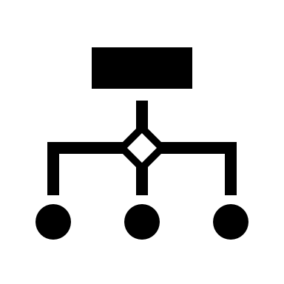
Techniques Employed to Prevent Overfitting
In my project to prevent overfitting, I implemented several strategies:
Data Augmentation: Used techniques such as horizontal flipping and rescaling to increase the diversity of the training data.
Dropout Layers: Added dropout layers to randomly deactivate neurons during training, reducing the risk of overfitting.
Hyperparameter Tuning: Utilised Keras Tuner for hyperparameter tuning to find the best model configuration.

Slide 11
Chosen Techniques & Reasoning
Transfer Learning(CNNs): Focus on high accuracy and efficiency for image classification tasks using deep neural networks designed for image data.
SSTL: Combines supervised and unsupervised learning to enhance performance and generalisation when labelled data is limited.
SRL: Integrates supervised learning with reinforcement learning to optimise decision-making through rewards, suitable for tasks requiring dynamic adjustments.
Each technique has its unique strengths and applications, making them suitable for different types of tasks and data availability scenarios in the context of brain tumour classification.

Slide 12
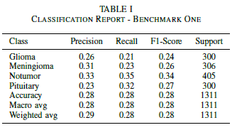
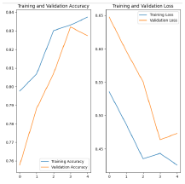
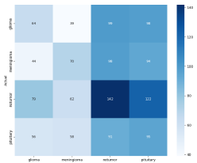
Supervised Transfer Learning - EfficientNetB0
Glioma: The model correctly classifies 64 instances but
Misclassifies a significant number of instances into other
Categories, particularly ’notumor’ and ’pituitary’.
Meningioma: The model correctly identifies 70 instances but has a high rate of misclassification, especially into ’notumor’.
Notumour: This category has the highest correct classification
(142) but still suffers from substantial misclassifications.
Pituitary: The correct classification count is 95, with notable confusion with ’notumor’.
Notes:
The classification report highlights that the model struggles with significant misclassification across categories, evidenced by relatively low precision, recall, and F1-scores for all classes. The 'Notumor' category has the highest correct classification count (142), yet still faces substantial misclassification issues. Similarly, while the 'Pituitary' class has a better correct classification count (95), it notably confuses instances with 'Notumor'. The confusion matrix and accuracy graphs further illustrate these misclassification patterns.
Key Results:
Glioma: Precision 0.26, Recall 0.21, F1-Score 0.24
Meningioma: Precision 0.31, Recall 0.23, F1-Score 0.26
Notumor: Precision 0.33, Recall 0.35, F1-Score 0.34
Pituitary: Precision 0.23, Recall 0.32, F1-Score 0.27
Overall Accuracy: 0.28
Suggested Improvements for Future Research:
Enhanced Feature Engineering: Incorporate more discriminative features to help the model better differentiate between classes.
Advanced Algorithms: Experiment with more sophisticated algorithms like ensemble methods or deep learning models which may offer better classification performance.
Hyperparameter Tuning: Implement extensive hyperparameter tuning to find the optimal settings for the current model.
Class Imbalance Handling: Apply techniques such as oversampling, undersampling, or synthetic data generation (e.g., SMOTE) to address class imbalances.
Regulariaation Techniques: Utilise regularisation to avoid overfitting and improve generalization on unseen data.
Cross-Validation: Employ k-fold cross-validation to ensure the robustness and reliability of the model's performance metrics.

Slide 13
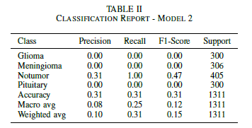
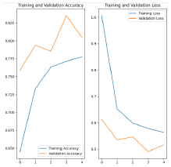
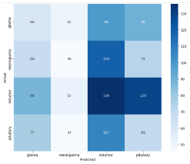
Supervised Reinforcement Learning - EfficientNetB0 With a Custom Reward Environment
Enhanced data augmentation techniques increased rotation, shift parameters, and brightness adjustments, reducing overfitting.
Applied class weights to address class imbalances, giving more weight to underrepresented classes.
Glioma: Correctly classified 60 instances, with slight improvement but still many misclassifications into 'notumor' and 'pituitary'.
Meningioma: Correctly identified 46 instances, showing decreased performance compared to the first model.
Notumor: Highest correct classification with 136 instances, a slight decrease from the first model.
Highlight: Learning Curves show training accuracy peaking briefly around 82% and validation accuracy around 83%.
Further experimentation is needed to fine tune further for optimum results.
Notes:
The image presents an overview of the advancements made in the second iteration of a supervised reinforcement learning model using EfficientNetB0 with a custom reward environment. It highlights several improvements aimed at enhancing model performance and reducing overfitting.
Key Advancements:
Enhanced Data Augmentation: Implemented increased rotation, shift parameters, and brightness adjustments to create a more diverse training dataset, reducing overfitting.
Class Weights: Applied class weights to address class imbalances, giving more weight to underrepresented classes and improving performance across all classes.
Improved Glioma Classification: Correctly classified 60 instances, showing slight improvement but still misclassifying many instances into 'notumor' and 'pituitary’.
Decreased Meningioma Classification: Correctly identified 46 instances, indicating decreased performance compared to the first model.
Highest Notumor Classification: Achieved the highest correct classification with 136 instances, though showing a slight decrease from the first model.
Overall Accuracy: Learning curves show training accuracy reaching around 82% and validation accuracy around 83%, with an overall accuracy of 24% and macro and weighted averages around 23-24%.

Slide 14
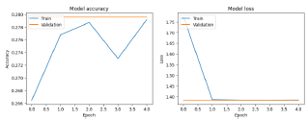
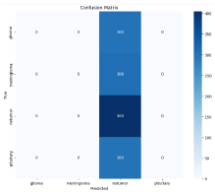
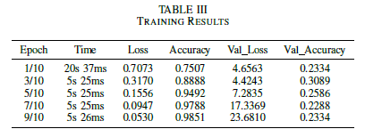
Further Experimentation
Utilised a custom hybrid approach combining supervised learning and reinforcement learning techniques.
Performed data augmentation and preprocessing using TensorFlow Keras’s ImageDataGenerator to enhance dataset diversity and robustness.
Constructed a deep learning model based on EfficientNetB0, fine-tuned for accurate brain tumour classification.
Optimised model parameters like learning rate and dropout rate using Keras Tuner's Random Search strategy.
Introduced a custom callback for additional rewards through reinforcement learning, integrating it into the training process.
Evaluated model performance with a confusion matrix and classification report, highlighting significant misclassification issues, particularly in glioma, meningioma, and pituitary classes, with overall accuracy at 0.31.
Notes:
This slide summarises further experimentation with a custom hybrid approach combining supervised learning and reinforcement learning techniques. Data augmentation and preprocessing were performed using TensorFlow Keras's ImageDataGenerator to enhance dataset diversity and robustness. A deep learning model based on EfficientNetB0 was constructed and fine-tuned for accurate brain tumour classification. Hyperparameter tuning was facilitated by Keras Tuner's Random Search strategy to optimise model parameters such as learning rate and dropout rate. A custom callback was introduced to provide additional rewards through reinforcement learning, integrating it into the training process. The model's performance was evaluated using a confusion matrix and a classification report, which highlighted significant misclassification issues, particularly in glioma, meningioma, and pituitary classes, with an overall accuracy of 0.31. Compared to the previous models, this iteration showed minimal improvements, with persistent difficulties in correctly classifying certain tumour types.

Slide 15
Conclusions
Data Augmentation: Enhanced data augmentation methods contribute to improved model robustness but are insufficient alone to significantly enhance classification accuracy.
Class Imbalance Handling: Applying class weights can help balance training, yet substantial misclassification persists, indicating the complexity of the problem.
Reinforcement Learning Integration: While incorporating reinforcement learning provided a novel approach, it did not lead to substantial improvements in this context.
Need for Further Research: The consistent challenges across all three methods suggest the necessity for more sophisticated models, possibly involving more advanced deep learning architectures, improved data preprocessing techniques, and further exploration of hybrid learning approaches.
Notes:
Key Takeaways

Slide 16
Random Forest Slides
Brain Tumour Classification Using Machine Learning
Notes:
I will be presenting our work on 'Brain Tumor Classification Using Machine Learning: A Comparative Analysis of RandomForestClassifier, LogisticRegression, and LGBMClassifier(Light Gradient Boosting Machine).'
Aziz note:
I will be the one who will introduce the machine learning approach to brain tumour classification involving several key steps. We began by preprocessing MRI images to ensure consistency and quality. Next, we extracted features from these images to capture essential details. We trained multiple machine learning models, including RandomForestClassifier, LogisticRegression, and LGBMClassifier. We performed hyperparameter tuning to optimize each model's performance. Finally, we evaluated and compared these models using various performance metrics to determine the most effective classifier for accurately identifying brain tumour types.
This approach aims to improve the accuracy and efficiency of brain tumor diagnosis through advanced machine learning techniques.

Slide 17
Preprocessing and Feature Extraction
Preprocessing Steps:
Resizing: Images resized to 128x128 pixels for uniformity.
Normalization: Pixel values scaled to the range [0, 1].
Label Encoding: Labels encoded into numerical format.
Feature Extraction Techniques:
SIFT (Scale-Invariant Feature Transform):
ORB (Oriented FAST and Rotated BRIEF)
HOG (Histogram of Oriented Gradients)
Notes:
•These steps ensure that the data is in a suitable format for training our machine learning models.
Feature extraction is a critical step in our process, ensuring that our models have robust and discriminative features to learn from

Slide 18
Data Normalization, Flattening, and Model Selection
Data Normalization and Flattening:
Normalization: Pixel values scaled to the range [0, 1].
Flattening: Images flattened and combined with HOG and ORB features into a single feature vector.
Model Selection and Hyperparameter Tuning: Models:
RandomForestClassifier
LogisticRegression
LGBMClassifier
Hyperparameter Tuning:
Manually iterated over various sets of hyperparameters to find the best configuration for each model.
Notes:
•This comprehensive feature set is then used to train our machine learning models, providing them with detailed and useful information.
•Hyperparameter tuning is essential to optimize each model's performance, enhancing accuracy and robustness.

Slide 19
Training, Validation, and Evaluation Metrics
Training and Validation: Data Split:
"80% training set and 20% validation set."
Techniques:
Cross-validation to ensure generalization to new data.
Learning curves to visualize model performance over time.
Evaluation Metrics:
Accuracy: Proportion of correctly classified instances.
Precision: Proportion of true positives out of predicted positives.
Recall: Proportion of true positives out of actual positives.
F1-score: Harmonic mean of precision and recall.
Notes:
•These methods help us identify if the models are overfitting or underfitting, ensuring reliable performance.
•These metrics provide a comprehensive view of our models' performance, highlighting strengths and areas for improvement.

Slide 20
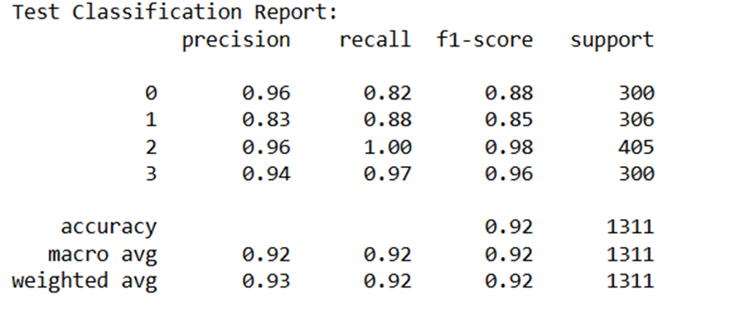
Random Forest Classifier Test Classification Reports
RandomForestClassifier:
Precision: 0.96 for 'notumor' and 0.83 for 'meningioma'.
Recall: 0.82 for 'notumor' and 0.88 for 'meningioma'.
F1-score: 0.88 for 'notumor' and 0.85 for 'meningioma'.
Overall accuracy: 92%.
Notes:
"Our Random Forest Classifier Test Classification Reports achieved an overall accuracy of 92%. The model performed exceptionally well in identifying 'notumor' cases with a perfect recall of 1.00 and a precision of 0.96. For glioma, meningioma, and pituitary tumors, the precision and recall scores were also high, demonstrating the model's effectiveness across all tumor types. These results highlight the robustness and reliability of our classification approach."

Slide 21
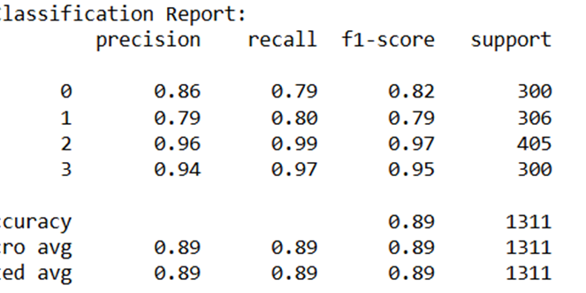
Logistic Regression Classifier Test Classification Reports
LogisticRegression:
Precision: 0.86 for 'notumor' and 0.79 for 'meningioma'.
Recall: 0.79 for 'notumor' and 0.80 for 'meningioma'.
F1-score: 0.82 for 'notumor' and 0.79 for 'meningioma'.
Overall accuracy: 89%.
Notes:
"Our other Logistic Regression Classifier Test Classification Reports achieved an overall accuracy of 89%. It showed strong performance in identifying 'notumor' cases with a recall of 0.99 and a precision of 0.96. For glioma, meningioma, and pituitary tumors, the precision and recall scores were high, particularly for pituitary tumors with a precision of 0.94 and recall of 0.97. These results indicate the model's solid performance across all tumor types, with particularly high effectiveness in detecting 'notumor' cases."

Slide 22
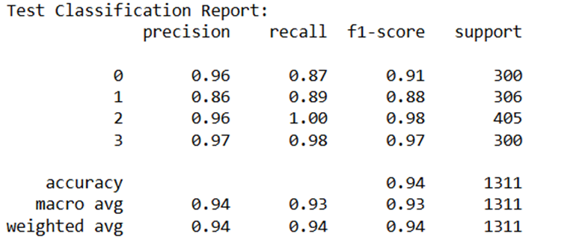
LGBM Classifier Test Classification Reports
LGBMClassifier:
Precision: 0.96 for 'notumor' and 0.86 for 'meningioma'.
Recall: 0.87 for 'notumor' and 0.89 for 'meningioma'.
F1-score: 0.91 for 'notumor' and 0.88 for 'meningioma'.
Overall accuracy: 94%.
Notes:
"Our last LGBM Classifier Test Classification Reports achieved an impressive overall accuracy of 94%. It performed exceptionally well in identifying 'notumor' cases with perfect recall of 1.00 and high precision of 0.96. For glioma, meningioma, and pituitary tumors, the model demonstrated high precision and recall scores, with particularly strong performance for pituitary tumors (precision of 0.97 and recall of 0.98). These results highlight the model's robustness and reliability, making it highly effective across all tumor types."

Slide 23
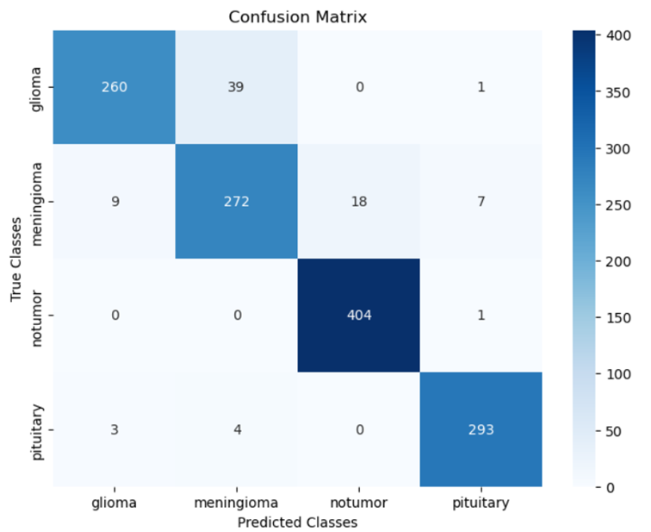
LGBM Classifier Confusion Matrix
Here is the confusion matrix for the LGBMClassifier. It shows the number of correct and incorrect predictions for each class. This matrix helps us understand the specific areas where the LGBMClassifier excels or needs improvement.
Notes:
The LGBMClassifier shows high accuracy in identifying 'notumor' and 'pituitary' classes, highlighting its effectiveness in these categories.

Slide 24
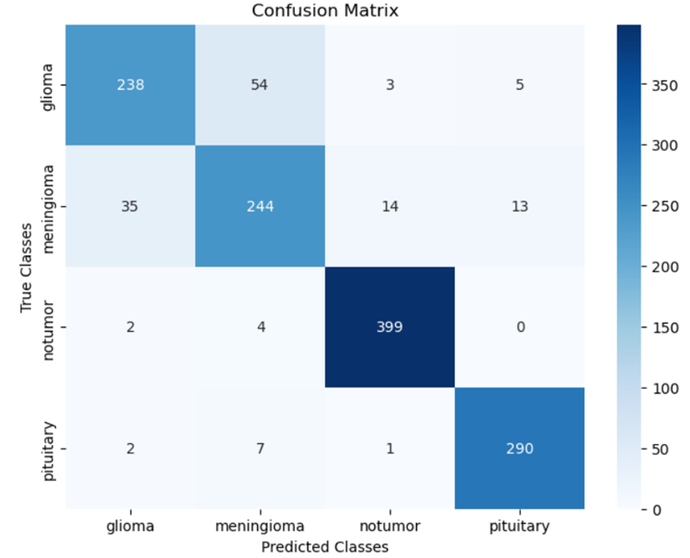
Logistic Regression Classifier Confusion Matrix
Here is the confusion matrix for the LogisticRegression model. It shows the number of correct and incorrect predictions for each class. This matrix helps us understand the specific areas where the LogisticRegression model excels or needs improvement.
Notes:
The LogisticRegression model performs well but has more misclassifications in 'glioma' and 'meningioma' classes compared to LGBMClassifier.

Slide 25

Random Forest Classifier Confusion Matrix
Here is the confusion matrix for the RandomForestClassifier. It shows the number of correct and incorrect predictions for each class. This matrix helps us understand the specific areas where the RandomForestClassifier excels or needs improvement.
Notes:
The RandomForestClassifier shows good performance but slightly lower than LGBMClassifier, especially in the 'glioma' class.

Slide 26
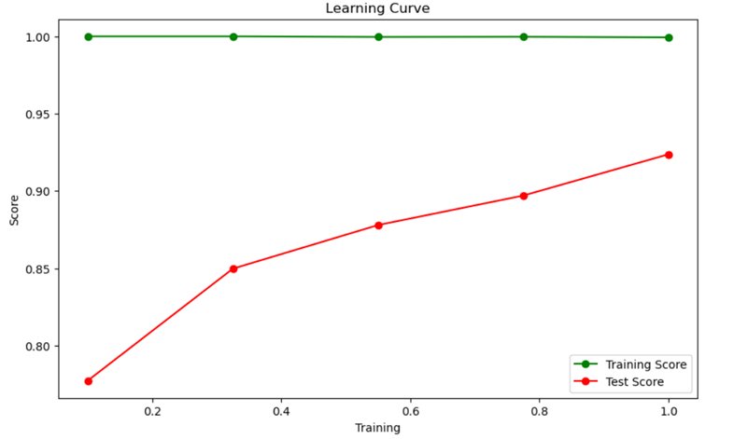
Random Forest Classifier Learning Curve
Initially, the test score starts below 0.80, then rises to almost 0.85. It stabilizes around the middle between 0.85 and 0.90, and finally reaches 0.92. The training score remains close to 100, gradually decreasing to around 98, indicating strong learning with slight overfitting.
Notes:
"Key findings from the Random Forest Classifier learning curve show that the test score initially starts below 0.80, then rises to nearly 0.85. It stabilizes around the midpoint between 0.85 and 0.90, and eventually reaches 0.92. Meanwhile, the training score remains close to 100, gradually decreasing to around 98, indicating strong learning with slight overfitting."

Slide 27
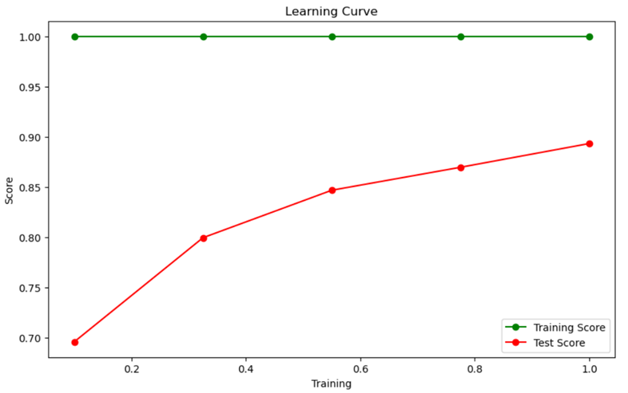
Logistic Regression Classifier Learning Curve
The LogisticRegression learning curve shows that the test score starts a bit below 0.70, then increases to 0.80. It continues to improve to 0.85, then approaches the middle between 0.85 and 0.90, and ends at 0.89. The training score, like the others, starts near 100 and gradually declines to around 98.
Notes:
"Key findings from the LogisticRegression learning curve reveal that the test score begins slightly below 0.70 and progressively improves, first reaching 0.80, then 0.85, moving to a midpoint between 0.85 and 0.90, and finally ending at 0.89. The training score starts near 100 and gradually declines to around 98, indicating strong model performance with minimal overfitting and good generalization to new data."

Slide 28
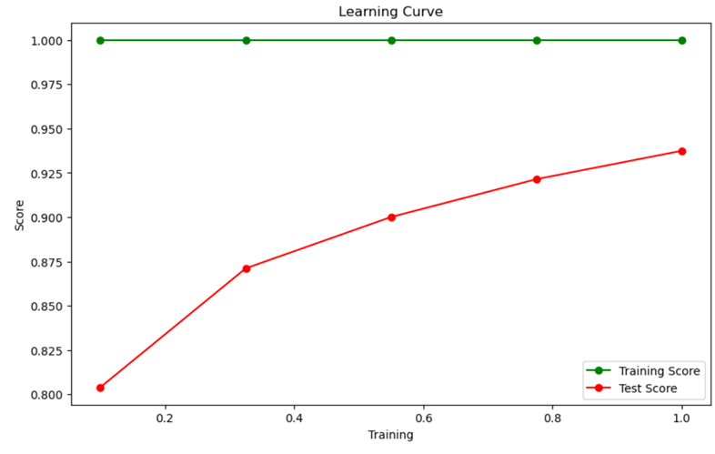
LGBM Classifier Learning Curve
The LGBMClassifier learning curve indicates that the test score starts slightly above 0.80, then climbs to nearly 0.875. It then reaches 0.90, almost 0.925, and finally hits 0.94. The training score starts near 100 and steadily decreases to about 98, showing excellent performance with minimal overfitting.
Notes:
"Key findings from the LGBMClassifier learning curve indicate that the model's test score starts slightly above 0.80 and steadily improves, reaching nearly 0.875, then 0.90, almost 0.925, and finally hitting 0.94. Concurrently, the training score starts near 100 and slightly decreases to about 98, demonstrating excellent performance with minimal overfitting. This trend highlights the model's robustness and its ability to generalize well to new data."

Slide 29
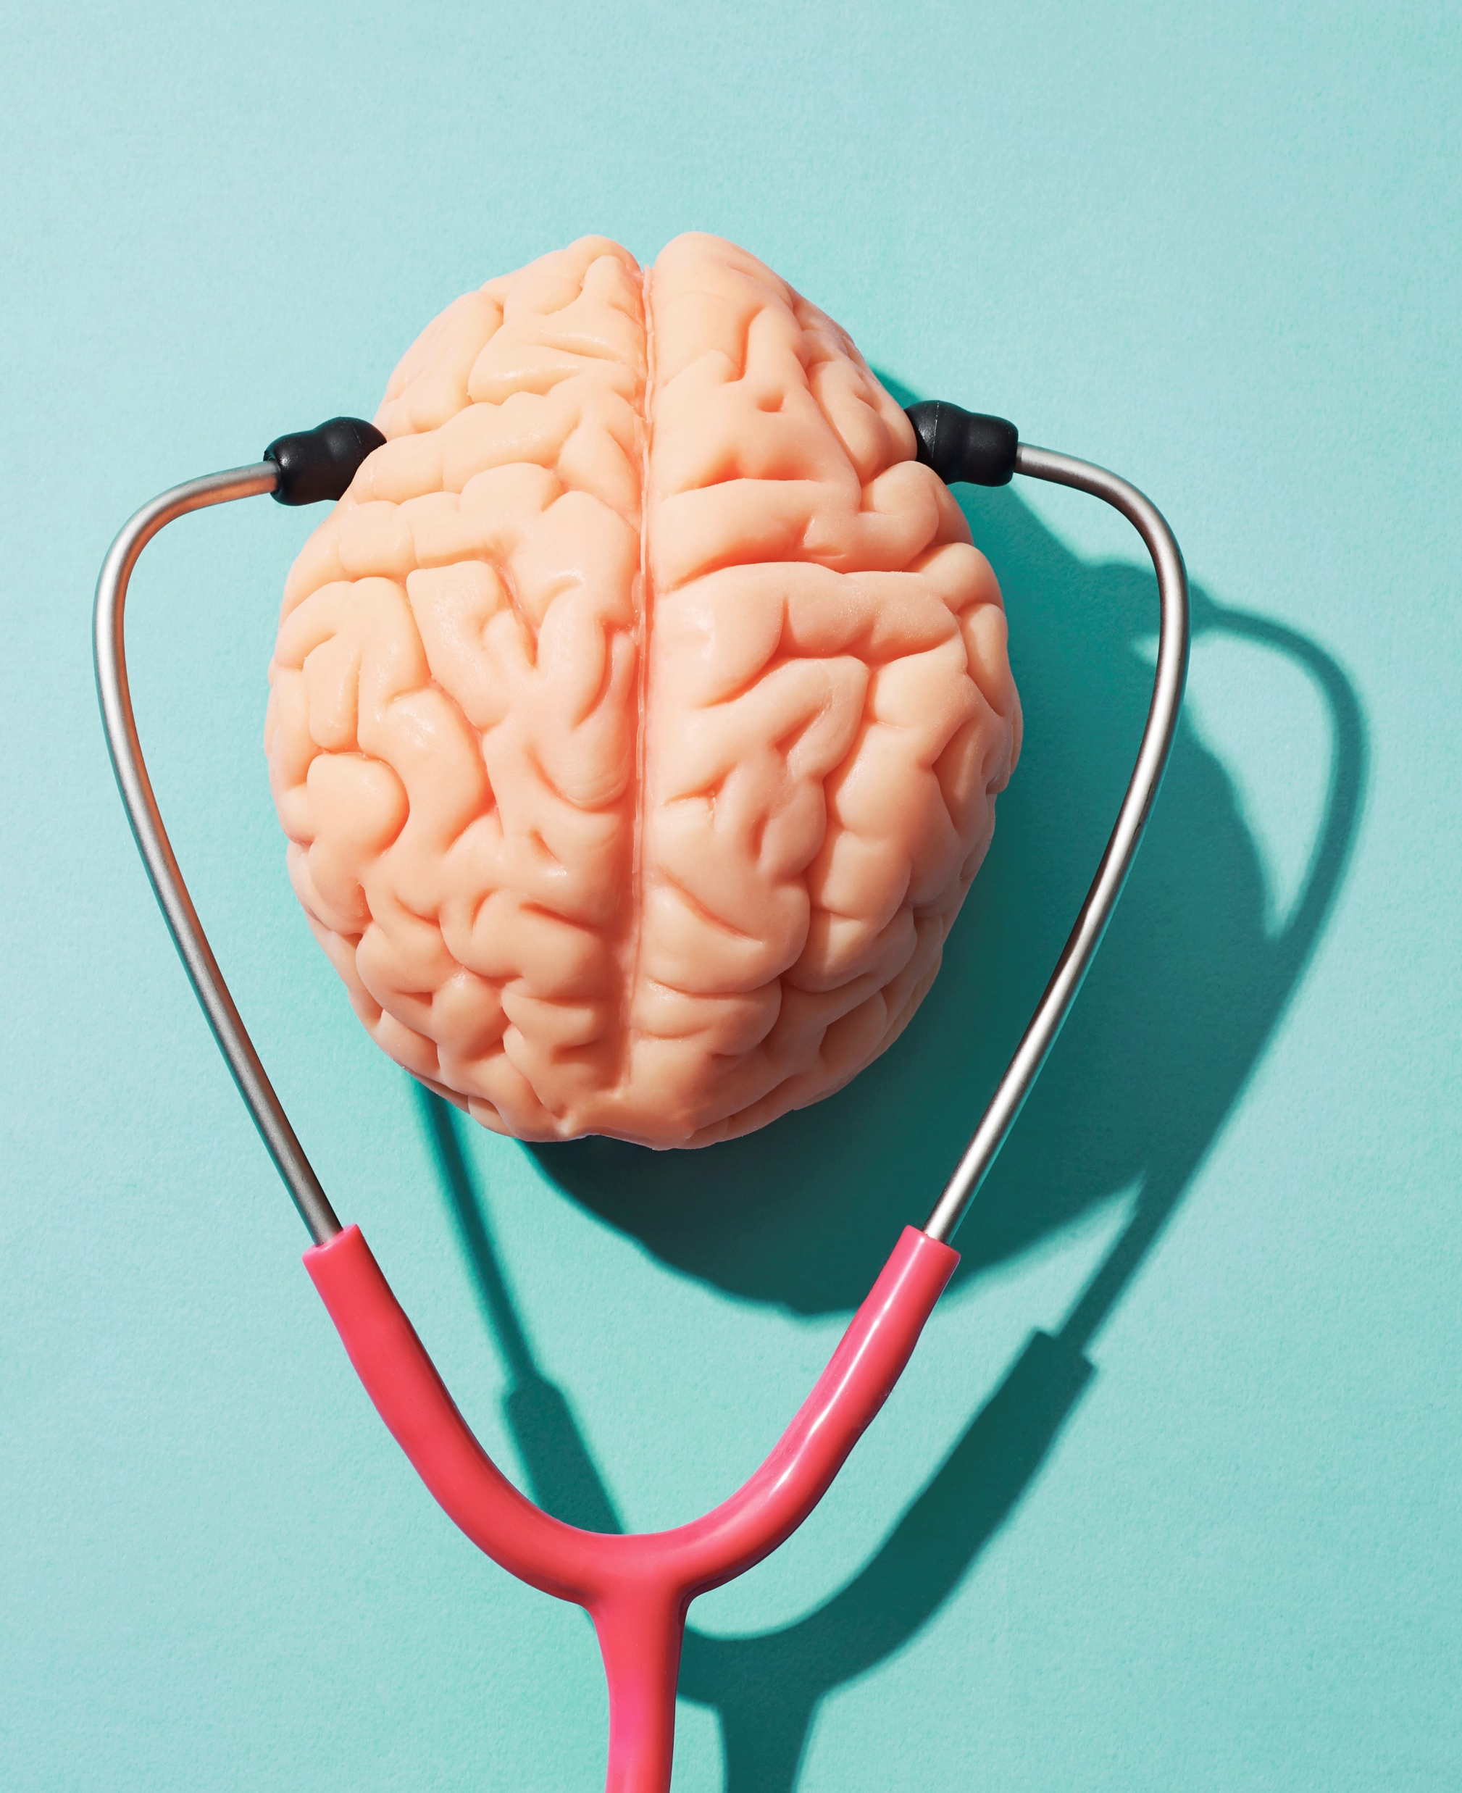
Conclusions
CNNs: Achieved high accuracy and efficiency through automatic feature extraction from MRI images. Best performance with training accuracy of 75% and test accuracy of 63% in the third benchmark.
Semi-Supervised Transfer Learning (SSTL) and Supervised Reinforcement Learning (SRL): Utilised pre-trained models fine-tuned with limited labelled data, showing potential for improved performance and generalisation despite mixed results and misclassifications.
Random Forests (RF): Emphasised interpretability and robustness by combining multiple decision trees, achieving high test accuracy up to 92%, making it suitable for clinical applications.
Potential for Further Development: Semi-Supervised and Supervised Reinforcement Learning approaches hold promise for future advancements.
Clinical Relevance: Random Forests provided robust and interpretable solutions, proving useful for clinical settings.
Notes:
The study evaluated three methodologies for brain tumour classification: CNNs, Semi-Supervised Transfer Learning (SSTL) and Supervised Reinforcement Learning (SRL), and Random Forests (RF). CNNs, leveraging automatic feature extraction from MRI images, achieved high accuracy and efficiency, with the best performance in the third benchmark, showing a training accuracy of 75% and a test accuracy of 63%. SSTL and SRL utilised pre-trained models fine-tuned with limited labelled data, demonstrating significant potential for improved performance and generalisation despite mixed results and notable misclassifications. Random Forests, focusing on interpretability and robustness, achieved high test accuracy of up to 92%, proving robust for clinical applications. Overall, CNNs emerged as the most effective methodology, particularly where accuracy and efficiency are critical. The Semi-Supervised and Supervised Reinforcement Learning approaches hold promise for further development, while Random Forests offer robust and interpretable solutions suitable for clinical settings.

Slide 30

Live Demo of Code & EVA

Slide 31
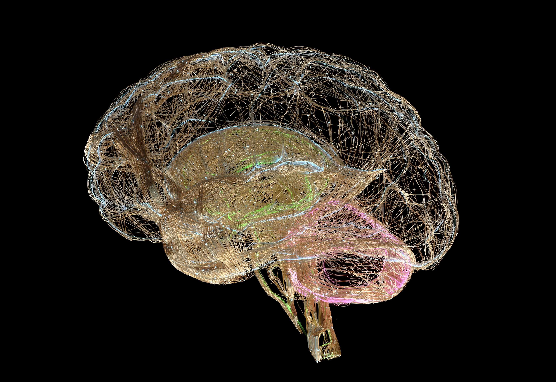
Group Work Discussions
Notes:
Working with the team on this project was an excellent experience. We collaborated effectively, meeting regularly to discuss our progress and refine our ideas. Early on, we quickly decided on our approach and selected an anonymised dataset from Kaggle.
From there, we brainstormed various techniques we wanted to explore, ensuring we leveraged each member's strengths and insights. It was fascinating to compare our results afterwards, as each approach offered unique and valuable contributions.
This collaborative coding project was incredibly beneficial and reflective of actual work environments. It emphasised the importance of teamwork, communication, and combining diverse perspectives to achieve a common goal. Overall, this experience underscored the value of collaborative efforts in producing comprehensive and innovative solutions.

Slide 32

Questions?

